Slide 1
Thinking of and with data: How students and teachers (and researchers) use data in STEM education
Joshua M. Rosenberg, Doctoral Candidate
Michigan State University
January 24th, 2018
University of Tennessee, Knoxville
Department of Theory and Practice of Teacher Education
Notes:
Work with data
Also implications
Mention NGSS
Make a slide
Thank you to the Mehmet Aydeniz and the search committee and the faculty and students in the TPTE department as well as Ms. Gina Guinn for making this trip possible.
This talk is on thinking of and with data in STEM.
In particular, this talk is focused on the affordances of new sources of data for teachers and students.
And, is on how new sources of data can help us understand teaching and learning in STEM.
Work with data can help students (and teachers) across STEM classrooms to go beyond “doing school” to engage in disciplinary practices, such as analyzing and interpreting data and developing and using models. Using authentic sources of data in classroom contexts can be challenging because of the time and planning such work takes as well as how it differs from how students have traditionally worked with data at school. In this talk, I describe research on how students engage with authentic sources of data in science classrooms and summer STEM enrichment programs. Also, I show how researchers can use a variety of data sources and methods to understand student engagement with data and other science and STEM activities. I discuss implications for teachers, teacher educators and professional development providers, and for the design of educational technologies. Finally, I outline some future directions for uses of data across STEM disciplines.

Slide 2
Biography
Introduction | Text | ESM | Digital Traces | Future Work | Conclusion
Undergraduate degree in Biology from University of North Carolina Asheville, Burroughs Wellcome Fund Scholar
Taught H.S. Biology, Chemistry, and Earth Science
Motivated by challenges and opportunities from helping students to do science, particularly with technological tools
Doctoral degree at Michigan State University
Taught or assisted courses in teacher education, educational technology, and research methods
Apply research to teaching about technology integration in science education, especially on teachers’ Technological Pedagogical Content Knowledge (TPACK)
Notes:
why you went to grad school

Slide 3
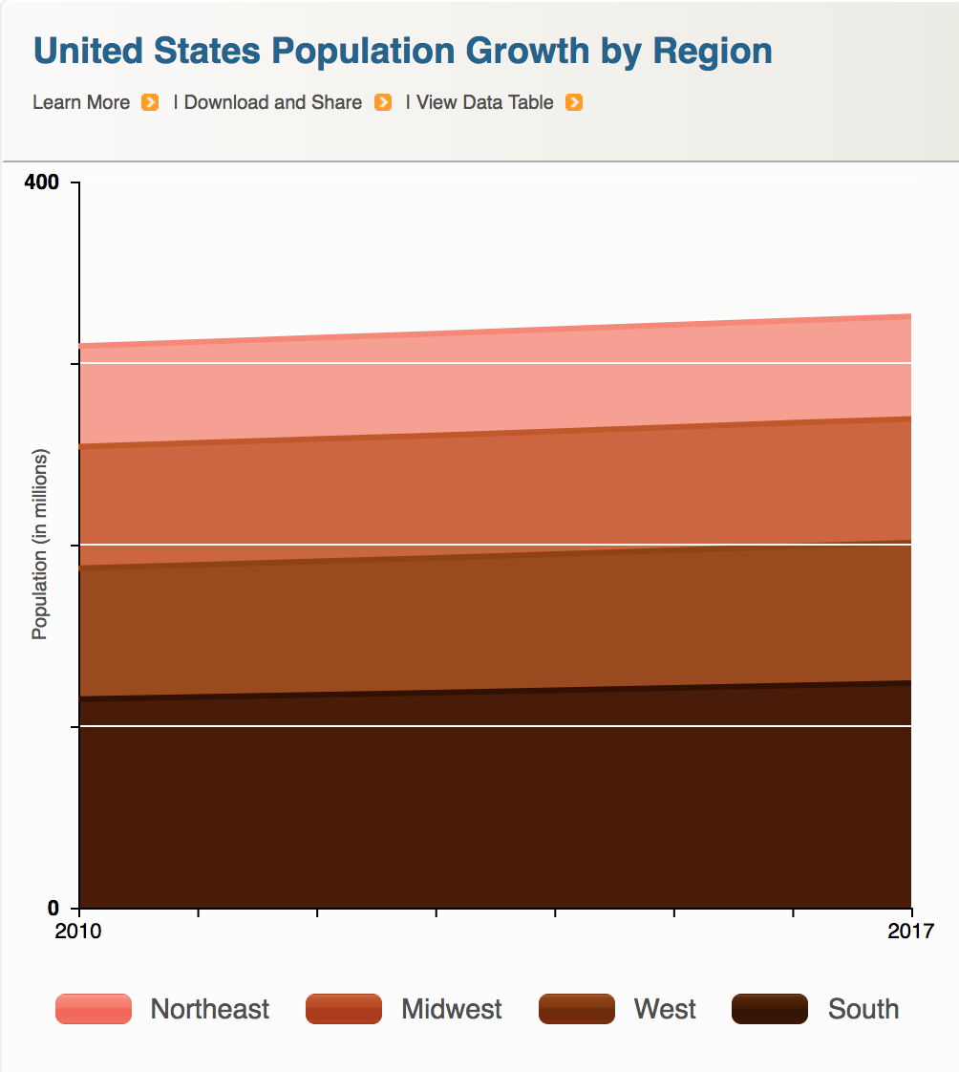
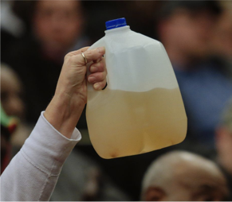

Data is power(ful)
Introduction | Text | ESM | Digital Traces | Future Work | Conclusion
Companies
Government
Citizens

Slide 4
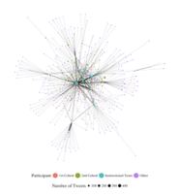
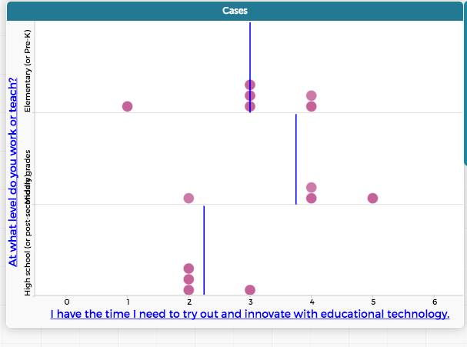
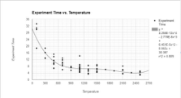
Data is power(ful)
Introduction | Text | ESM | Digital Traces | Future Work | Conclusion
Researchers
Teachers
Students
Notes:
talking about agency

Slide 5

Work with data
Introduction | Text | ESM | Digital Traces | Future Work | Conclusion

Slide 6
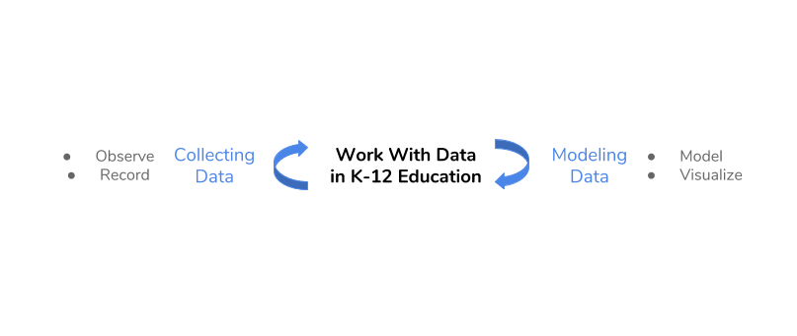
Work with data
Introduction | Text | ESM | Digital Traces | Future Work | Conclusion

Slide 7
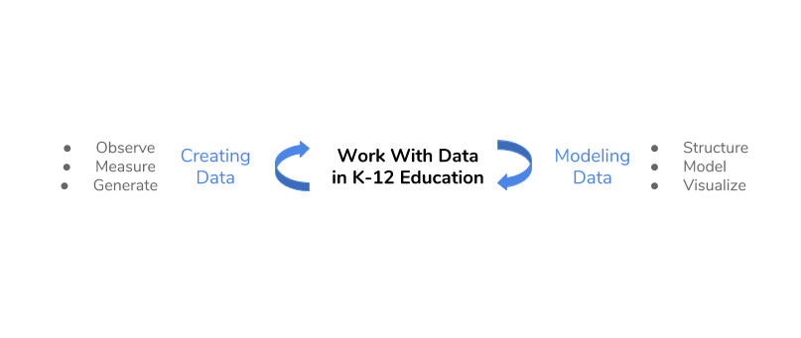
Work with data
Introduction | Text | ESM | Digital Traces | Future Work | Conclusion

Slide 8
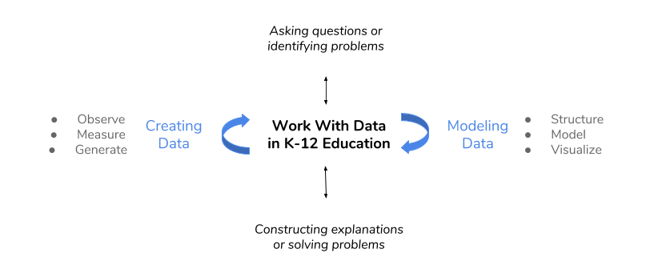
Work with data
Introduction | Text | ESM | Digital Traces | Future Work | Conclusion
Hancock, Kaput, & Goldsmith, 1992; Wild & Pfannkuch, 1999
NGSS Lead States, 2013; National Research Council, 2012

Slide 9
Work with data
Introduction | Text | ESM | Digital Traces | Future Work | Conclusion
Researchers’ design and development
Use of new data sources and methods for research
Hancock, Kaput, & Goldsmith, 1992; Wild & Pfannkuck, 1999
NGSS Lead States, 2013; National Research Council, 2012
Notes:
Requires sustained focus on one topic / phenomena
Shift from work with data in schools focusing on small, organized data sets
Requires using skills from across disciplines
Helps teachers and students to go beyond “doing school”
Provide opportunities for positive feedback loops
Can empower students to engage in inquiry in their lives Can prepare students for data-intensive occupations

Slide 10
Background
Introduction | Text | ESM | Digital Traces | Future Work | Conclusion
For students to work with data, they need support for teachers, tools, and curricula
For teachers to support work with data, they need time and professional development and support
For researchers to study work with data, they need to design contexts for work with data and to use new data sources and methods to study engagement and learning

Slide 11
Agenda
Introduction | Text | ESM | Digital Traces | Future Work | Conclusion
Studies organized around describing three data sources and identifying their affordances for work with data:
Experience sampling method (ESM)
Text data
Digital traces
Illustrating what we can learn through about work with data
Notes:
These are the guiding questions that setup the use and discussion of affordances of different data sources and then illustrations of what we can learn from them.
Goal is to show strengths of what kind of research we can do.
Big picture - need to convey this
need to show data source
How the studies are connected
How the studies fit in with the aim
What they help us understand about teaching and learning

Slide 12
Introduction | Text | ESM | Digital Traces | Future Work | Conclusion
Text Data
Experience Sampling Method
Digital Traces
Future Work
Notes:
The organization of the talk is to discuss three data sources, their affordances, and what we can learn about teaching and learning in STEM from work with them.
Understand learning over time and from moment-to-moment (Cobb, Confrey, DiSessa, Lehrer, & Schauble, 2003)
Explore STEM teaching and learning in classroom contexts (Hatch, 2002)
Document complex teaching and learning process (Salganik, 2017)
Go beyond “doing school” and empower students to think of and with data (Berland, Schwarz, Krist, Lo, & Reiser, 2016; Horton & Hardin, 2015)
Support positive feedback loops with other school subjects
Use digital methods and data sources (Mishra, Koehler, & Greenhow, 2015; Baker & Siemens, 2015)

Slide 13
Introduction | Text | ESM | Digital Traces | Future Work | Conclusion
Text Data
Experience Sampling Method
Digital Traces
Future Work

Slide 14
Affordances
Introduction | Text | ESM | Digital Traces | Future Work | Conclusion
Can understand teaching and learning in teachers’ and students’ “own words”
Can learn about considerations of teachers and students experiences that were not anticipated at the outset

Slide 15
How do teachers develop reform-based pedagogical practices?
Introduction | Text | ESM | Digital Traces | Future Work | Conclusion
Explored how two fifth-grade science teachers diverged in their use of scientific modeling in their teaching (Rosenberg, Schwarz, & Akcaoglu, revise and resubmit, JTE)
Project was focused on students’ creation, critique, and revision of models (Schwarz, Ke, Lee, & Rosenberg, 2014, ICLS)
One teacher became modeling-centered whereas the other stopped using modeling after the project ended
Notes:
define models'

Slide 16
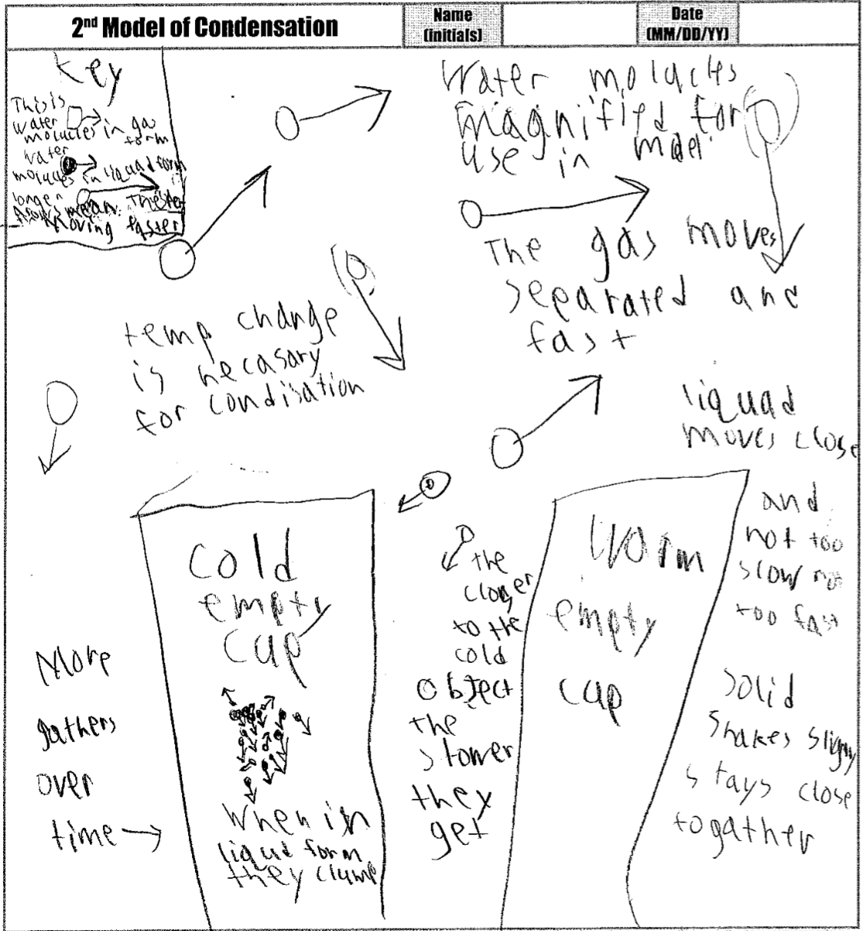
How do teachers teach scientific modeling?
Introduction | Text | ESM | Digital Traces | Future Work | Conclusion
Notes:
define models'

Slide 17
Mrs. M - Earlier
Introduction | Text | ESM | Digital Traces | Future Work | Conclusion
“I did feel at first that I was doing something wrong, but then it was my classroom and I just thought, "Let's just go with it and see what we get.”
“A lot of my kids certainly still hold misconceptions, but they got rocked, too, because of the different models that we used.”
Notes:
“When you throw in their own drawings and you throw in the times that we photocopied them or put them on transparencies and used them on the overhead, we were introducing countless models to them. And they were using one another's ideas. That was the greatest part about this whole experience - how trusting they were.

Slide 18
Mrs. M - Later
Introduction | Text | ESM | Digital Traces | Future Work | Conclusion
“I used to think modeling was just the picture or something you wrote. But after this experience it's really a process. We all come in with these ideas, and at fifth grade they come in with sometimes some really strange things.”
“So that evolution process of models is what's really been something that's kind of changed my own thinking. It's not just, , here, this is the end of it.”
Notes:
." . . . We constantly change the things that we think about through our own experiences or things that we learn.”
say some out loudOnce you get them to share those ideas, the coolest part is seeing them - not to say that they're wrong - but seeing them adapt and evolve those into a better understanding of what's really going on ...

Slide 19
Mr. H - Earlier
Introduction | Text | ESM | Digital Traces | Future Work | Conclusion
“I just think when we’re teaching something new to the kids, it doesn’t have to be that complex. [Modeling] is something they can hold onto and grasp.”
“That was a tough one to do, coming up with different ideas and activities and being able to execute them well . . . Because it always came back to the can. Here we are a month into it and we’re still talking about the can.”
Notes:
come back to tech
redundancy

Slide 20
Mr. H - Later
Introduction | Text | ESM | Digital Traces | Future Work | Conclusion
“I felt pressured with all the other things I was expected to do and not having enough time to do it. Because modeling took so much time and it was something that, if it was part of my curriculum, I would have had no problem with.”
“Because it was a research thing and it was on top of what I had to teach, it was a lot of pressure … I felt that pressure of taking two or three months to work on this research project and I still need to cover all this other stuff for my students.”
Notes:
come back to tech
redundancy … And I guess it was nice because there weren't very many parents that questioned me on it. And maybe it's because we worked hard at showing them that this was good stuff, this was good teaching and learning. But if you're in a place where you don't have that support, that would be really tough. But I think you could totally take the experience with modeling and wrap around any existing curriculum. Take what a district has already and say, "How can we pop in modeling?" I think it's totally doable.”

Slide 21
Key findings
Introduction | Text | ESM | Digital Traces | Future Work | Conclusion
For Mrs. M a willingness to adapt resources and goals and a focus on students sharing their ideas aligned with modeling and provided a focal endeavor for the class
Modeling became effective for science learning
For Mr. H, using modeling as one tool of many and promoting accurate scientific ideas with evidence and logic, scientific modeling was too time intensive
Modeling became a frustrating endeavor that hindered other goals

Slide 22
Writing about the usefulness of science
Introduction | Text | ESM | Digital Traces | Future Work | Conclusion
Examined changes in middle school science students’ value and interest in science through a relevance intervention (Akcaoglu, Rosenberg, Ranellucci, & Schwarz, 2018, IJER)
Context and sample:
212 students in eight MS classrooms in a suburban area
Used students’ written responses to better understand the impact of students’ writing about the usefulness of what they were learning about
Students’ demonstrated different levels of cognitive processing (12.08% of text instead compared to 9.27% of text, t = 2.81; p < .05, d = .50)
Notes:
“If I am ever blowing up balloons for a party and I want to keep the balloons big, I will keep them in a warm room so the molecules speed up and spread out, hitting the sides of the balloons and expanding it. In a cold room, the molecules will slow down and come together and the balloons sides will close and become smaller.”

Slide 23
Introduction | Text | ESM | Digital Traces | Future Work | Conclusion
Text Data
Experience Sampling Method
Digital Traces
Future Work
Notes:
The organization of the talk is to discuss three data sources, their affordances, and what we can learn about teaching and learning in STEM from work with them.

Slide 24
Experience sampling method (ESM)
Introduction | Text | ESM | Digital Traces | Future Work | Conclusion
Involves asking people about their experiences using short surveys
Use of an app on phone
Every 15-30 minutes
“When you were signaled, how interested were you in what you were learning?”
Notes:
I know this past research is a stretch – I would like to keep this just for the moment :)

Slide 25
Affordances
Introduction | Text | ESM | Digital Traces | Future Work | Conclusion
Understand learning experiences in a qualitatively distinct way (Hektner, Schmidt, & Csikszentmihalyi, 2007)
Helps us to understand moment-to-moment changes in experiences and what impacts experiences
Allows us to understand experiences during activities rather than overall pre- and post-assessments of what did or did not work
Notes:
I know this past research is a stretch – I would like to keep this just for the moment :)
Importance (but under-emphasis on) context in research on teacher knowledge (Rosenberg & Koehler, 2015)
Role of context in explaining processes around teaching and learning with technology (Phillips, Koehler, & Rosenberg, 2016)

Slide 26
Purpose
Introduction | Text | ESM | Digital Traces | Future Work | Conclusion
Explored “business-as-usual” and hands-on science, activities using a person-in-context approach (Schmidt, Rosenberg, & Beymer, 2018, JRST)
Use of ESM data and person-oriented analysis
To understand how learning activities (e.g., laboratory activities or lecture) and being able to choose impact students’ engagement
Notes:
Demonstrate how data can be used to empower teachers and students.
What role this play

Slide 27
Context and Sample
Introduction | Text | ESM | Digital Traces | Future Work | Conclusion
12 high school classrooms
Large high school outside of a large metropolitan area
244 students, 4,136 responses
Notes:
Measures:
Experience Sampling Method for engagement and choice
Activities coded from video-recordings
Person-in-context approach:
Two step cluster analysis (Rosenberg, Schmidt, & Beymer, 2017)
Interpreted profile solutions on the basis of measures of fit, cross-validation, and concerns of parsimony

Slide 28
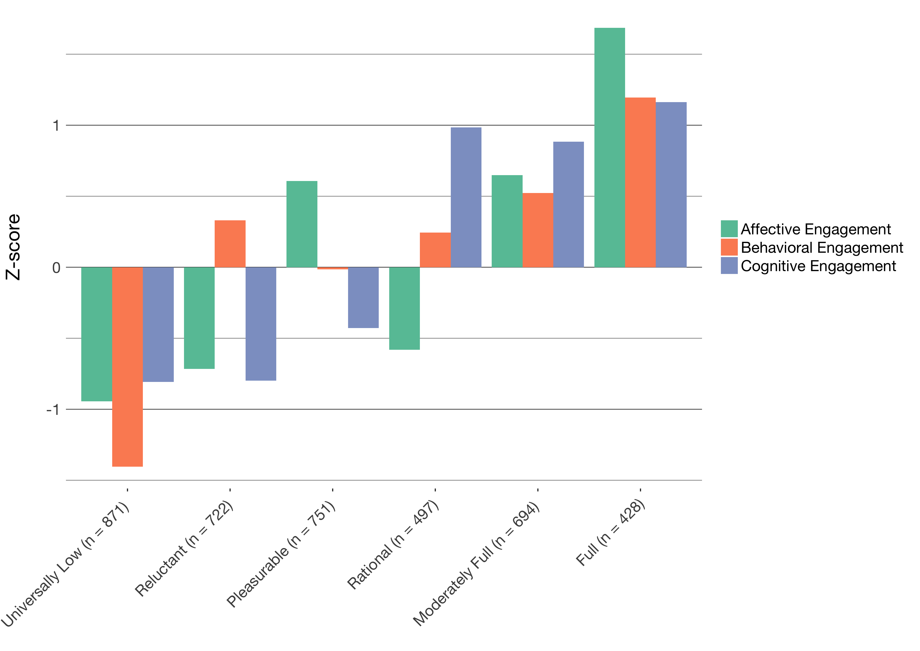
Profiles of engagement
Introduction | Text | ESM | Digital Traces | Future Work | Conclusion
Identified momentary profiles of engagement
Found six profiles from Universally Low to Full, with four complex patterns
Note that students report multiple profiles

Slide 29
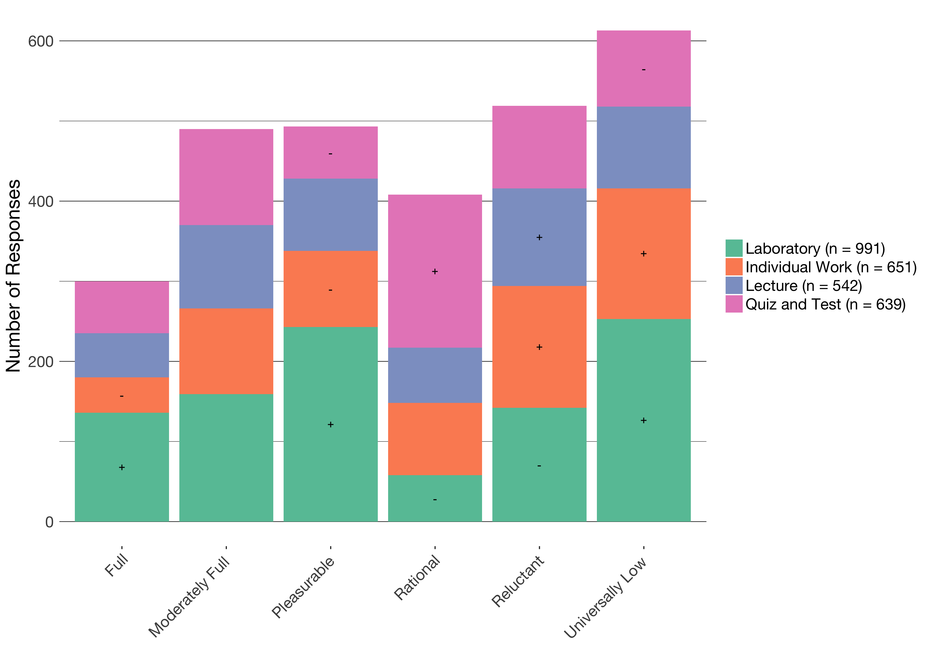
Profiles by activity
Introduction | Text | ESM | Digital Traces | Future Work | Conclusion

Slide 30
The impacts of activity on engagement
Introduction | Text | ESM | Digital Traces | Future Work | Conclusion
Different activities in science are associated with different profiles of engagement
Laboratory activities can be particularly engaging (and disengaging)
Quizzes and tests have some affordances in terms of students’ engagement
Individual work can be particularly disengaging

Slide 31
Profiles by choice
Introduction | Text | ESM | Digital Traces | Future Work | Conclusion
 | Universally Low | Reluctant | Pleasurable | Rational | Moderately Full | Full
Who | 1.43 *** | 1.19 | 1.00 | .35 *** | .44 | 1.20
Time | .38 *** | 0.47 | 0.49 | 1.82 *** | 1.26 | 0.47
How to Do | .45 | 1.07 | 0.48 | 0.46 | 1.14 | 1.35 *
Framing | .44 * | 0.46 | 0.48 | 1.14 | 1.06 | 1.60 ***

Slide 32
The impacts of choice on engagement
Introduction | Text | ESM | Digital Traces | Future Work | Conclusion
Choosing with whom to work is not associated with higher engagement
Choosing how much time to take is associated with rational engagement
Choosing how to do an activity or what the purpose or topic of the activity is associated with engaging profiles

Slide 33
The impacts of choice during laboratory
Introduction | Text | ESM | Digital Traces | Future Work | Conclusion
During laboratory, when students were able to make any choice (who, materials, time, how to do, framing, or other):
They are more likely to be fully engaged (z = 3.90, p < .05), which is not the case when they report no choice (z = -.23)

Slide 34
Key findings
Introduction | Text | ESM | Digital Traces | Future Work | Conclusion
Use of ESM allowed us to study the impacts of the learning activity and choice
Different activities in science are associated with different profiles of engagement
Providing chances for students to decide what to do or how to do it also impacts their engagement
As students move from activity to activity, their engagement can change
Notes:
Laboratory activities in science can be highly engaging
Choice—especially related to how students do laboratory activities and who determines how the activities is framed (choosing the purpose or topic)—is a key factor affecting how engaging laboratory activities are
Person-in-context approach helped us to characterize distinct profiles of engagement

Slide 35
Purpose
Introduction | Text | ESM | Digital Traces | Future Work | Conclusion
Studied work with data in summer STEM programs using profiles of engagement and its conditions (PECs) (Rosenberg, in preparation)
Can help us make informed recommendations and design activities and interventions focused on work with data
ESM can allow us to understand the impact of specific aspects of work with data or data modeling (Lehrer & Schauble, 2015)

Slide 36
Context and Participants and Measures
Introduction | Text | ESM | Digital Traces | Future Work | Conclusion
Context and Participants:
Nine summer STEM programs in urban areas in the Northeast
Highly diverse (90% of youth from historically under-represented [in STEM] groups)
204 youth, 2970 ESM responses
Measures:
ESM self-reports for cognitive, behavioral, and affective and perceptions of challenge and competence
Video-recordings of activities
Pre-program measures of interest

Slide 37
Coding frame for work with data
Introduction | Text | ESM | Digital Traces | Future Work | Conclusion
Work With Data | Description
Asking questions or defining problems | Discussing and exploring topics to investigate and pose questions.
Making observations | Watching and noticing what is happening with respect to the phenomena or problem being investigated.
Generating data | Figuring out how or why to record an observation as data and generating coding frames or measurement tools.
Data modeling | Understanding and explaining phenomena using models of the data that account for variability or uncertainty.
Interpreting and communicating findings | Discussing and sharing and presenting findings.
Notes:
shorten

Slide 38
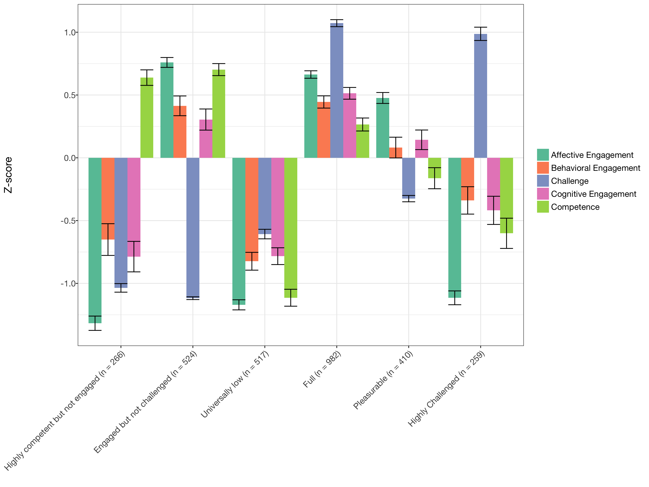
Profiles of engagement and its conditions
Introduction | Text | ESM | Digital Traces | Future Work | Conclusion
Developed tool for Latent Profile Analysis
Interpreted profiles using multiple criteria
Notes:
6 profiles, model 2, estimated in Mplus via tidyLPA
Change the order of the clustered variables
Need to name the profiles

Slide 39
Profiles of engagement and its conditions
Introduction | Text | ESM | Digital Traces | Future Work | Conclusion
When learners are challenged, they also need to think themselves as good at what they are doing to be highly engaged
When learners report Pleasurable engagement, their behavioral and cognitive engagement and perceptions of being challenged or good at the activity are moderate
When students report being Engaged but not Challenged, they may not be engaged in learning-related processes
Notes:
Mention more general findings

Slide 40
Work with data and engagement
Introduction | Text | ESM | Digital Traces | Future Work | Conclusion
When students report being Fully engaged:
Students are more likely to be generating data (B = 1.395, p = .029) and less likely to be observing phenomena (B = 0.410, p = .028)
Qualitative analysis of video suggests that modeling data is more often done by teachers (not students)
Notes:
6 profiles, model 2, estimated in Mplus via tidyLPA
Change the order of the clustered variables
Need to name the profiles

Slide 41
Key findings
Introduction | Text | ESM | Digital Traces | Future Work | Conclusion
Studying engagement at the moment-to-moment level helps us understand how specific activities related to work with data engage learners
Some aspects of work focused on generating or recording data are more engaging than others
Qualitative findings show that work with data is common but not always aligned with work in classroom contexts
Notes:
Next step

Slide 42
Introduction | Text | ESM | Digital Traces | Future Work | Conclusion
Text Data
Experience Sampling Method
Digital Traces
Future Work

Slide 43
Affordances
Introduction | ESM | Text | Digital Traces | Future Work | Conclusion
Study informal student and teacher learning in communities organized around interests or passions
Can capture rich data over a long period of time in teaching and learning settings
Notes:
Past research
Examined the role of State Educational Twitter Hashtags as educational affinity spaces (Rosenberg, Greenhalgh, Koehler, Hamilton, & Akcaoglu, 2016; Rosenberg, Akcaoglu, Staudt Willet, Greenhalgh, & Koehler, 2017)
Documented teachers’ technology knowledge evidenced through digital portfolios using the TPACK framework (Koehler, Greenhalgh, Rosenberg, & Keenan, 2017)

Slide 44
What can we learn about teachers’ technological understanding from digital portfolios?
Introduction | ESM | Text | Digital Traces | Future Work | Conclusion
Assessed teachers’ knowledge through digital portfolios as performance assessments (Koehler, Greenhalgh, Rosenberg, & Keenan, 2016, JTATE)
Analyzed portfolios from 589 students in Master of Arts in Educational Technology and Master of Arts in Education programs
Determine what artifacts teachers included and what they evidenced about teachers’ Technological Pedagogical Content Knowledge, or TPACK (Mishra & Koehler, 2006)
Focus on the program context as a factor that may impact the development of teachers’ TPACK (Rosenberg & Koehler, 2015)
Notes:
Put in portfolios

Slide 45
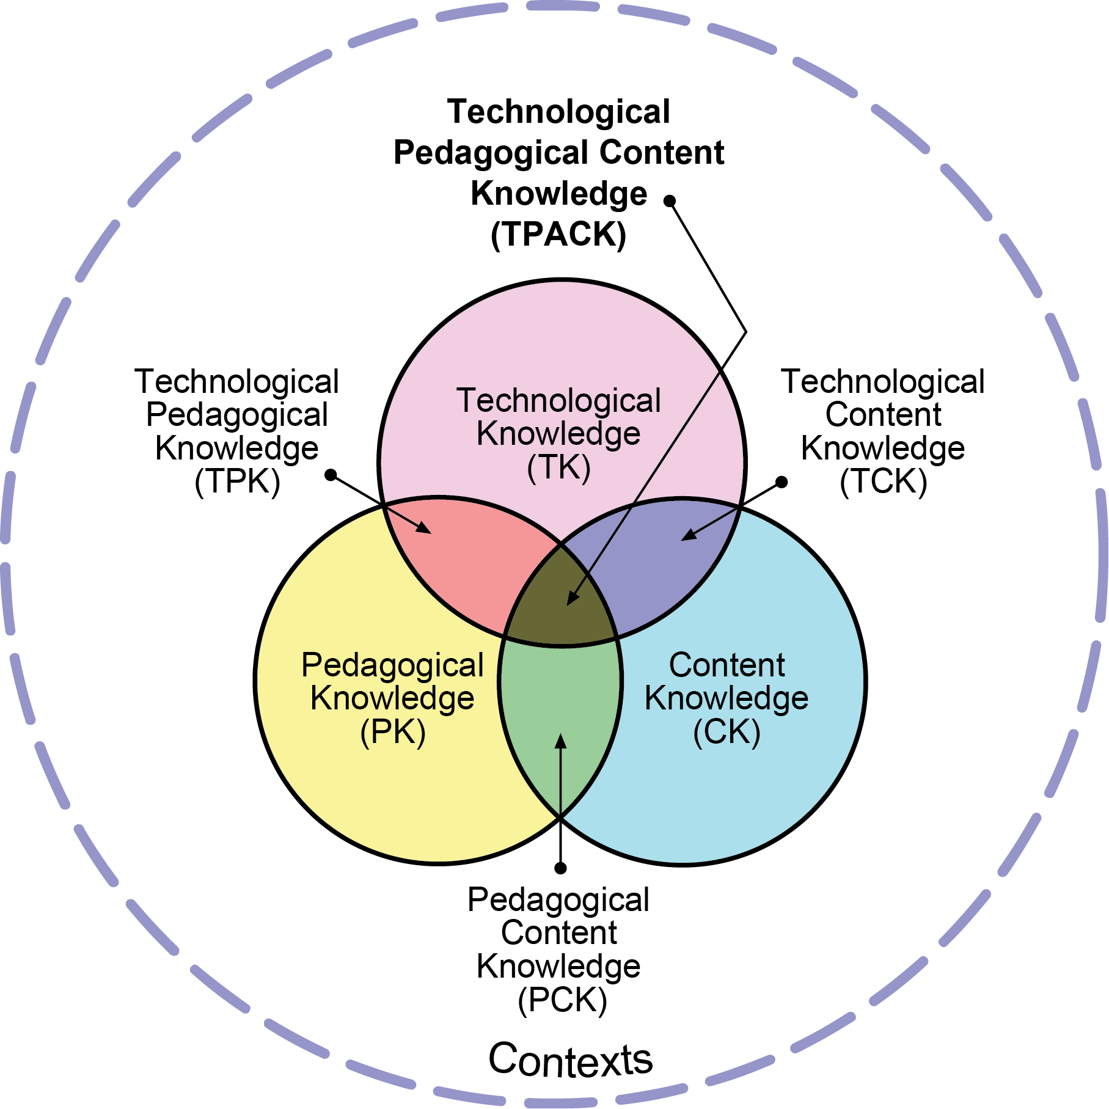
Technological Pedagogical Content Knowledge (TPACK)
Introduction | ESM | Text | Digital Traces | Future Work | Conclusion
Notes:
Put in portfolios

Slide 46
Coding frame for specific artifacts for TPACK
Level | TCK | TPK | TPACK
1 | .23 | .02 | .11
2 | .36 | .50 | .47
3 | .32 | .42 | .36
4 | .09 | .06 | .06
Mean | 2.25 | 2.52 | 2.38
Std. Dev | .92 | .65 | .77
Notes:
get rid

Slide 47
Content analysis of specific types of artifacts
Introduction | ESM | Text | Digital Traces | Future Work | Conclusion
Artifact Technology | Overall N = 895 | MAED n = 453 | MAET n= 442 | Difference
Web | .23 | .11 | .35 | -.23 ***
Social media | .02 | .01 | .04 | -.03 *
Multimedia | .16 | .08 | .24 | -.16 ***
Word processing | .12 | .12 | .11 | -.01
Document presentation | .39 | .63 | .14 | .49 ***
Presentation | .06 | .03 | .10 | -.07 ***
Other | .02 | .01 | .02 | -.01
Notes:
Put in portfolios

Slide 48
Findings
Introduction | ESM | Text | Digital Traces | Future Work | Conclusion
Digital portfolios can be used as performance assessments
The TPACK framework can guide an analysis of teachers’ technological understanding
Found differences in artifacts on the basis of students’ program
Notes:
Put in portfolios

Slide 49
How does community form among in-service STEM teachers?
Introduction | ESM | Text | Digital Traces | Future Work | Conclusion
Used social network analysis models and methods to understand the development of community among in-service STEM teachers in a graduate certificate program (Rosenberg, Greenhalgh, Wolf, & Koehler, 2017, JCMST)
Collected tweets associated with #MSUrbanSTEM hashtag and three cohorts of students
Supported development of community across different communication technologies and social media tools
Used network plots to explore the structure of community

Slide 50
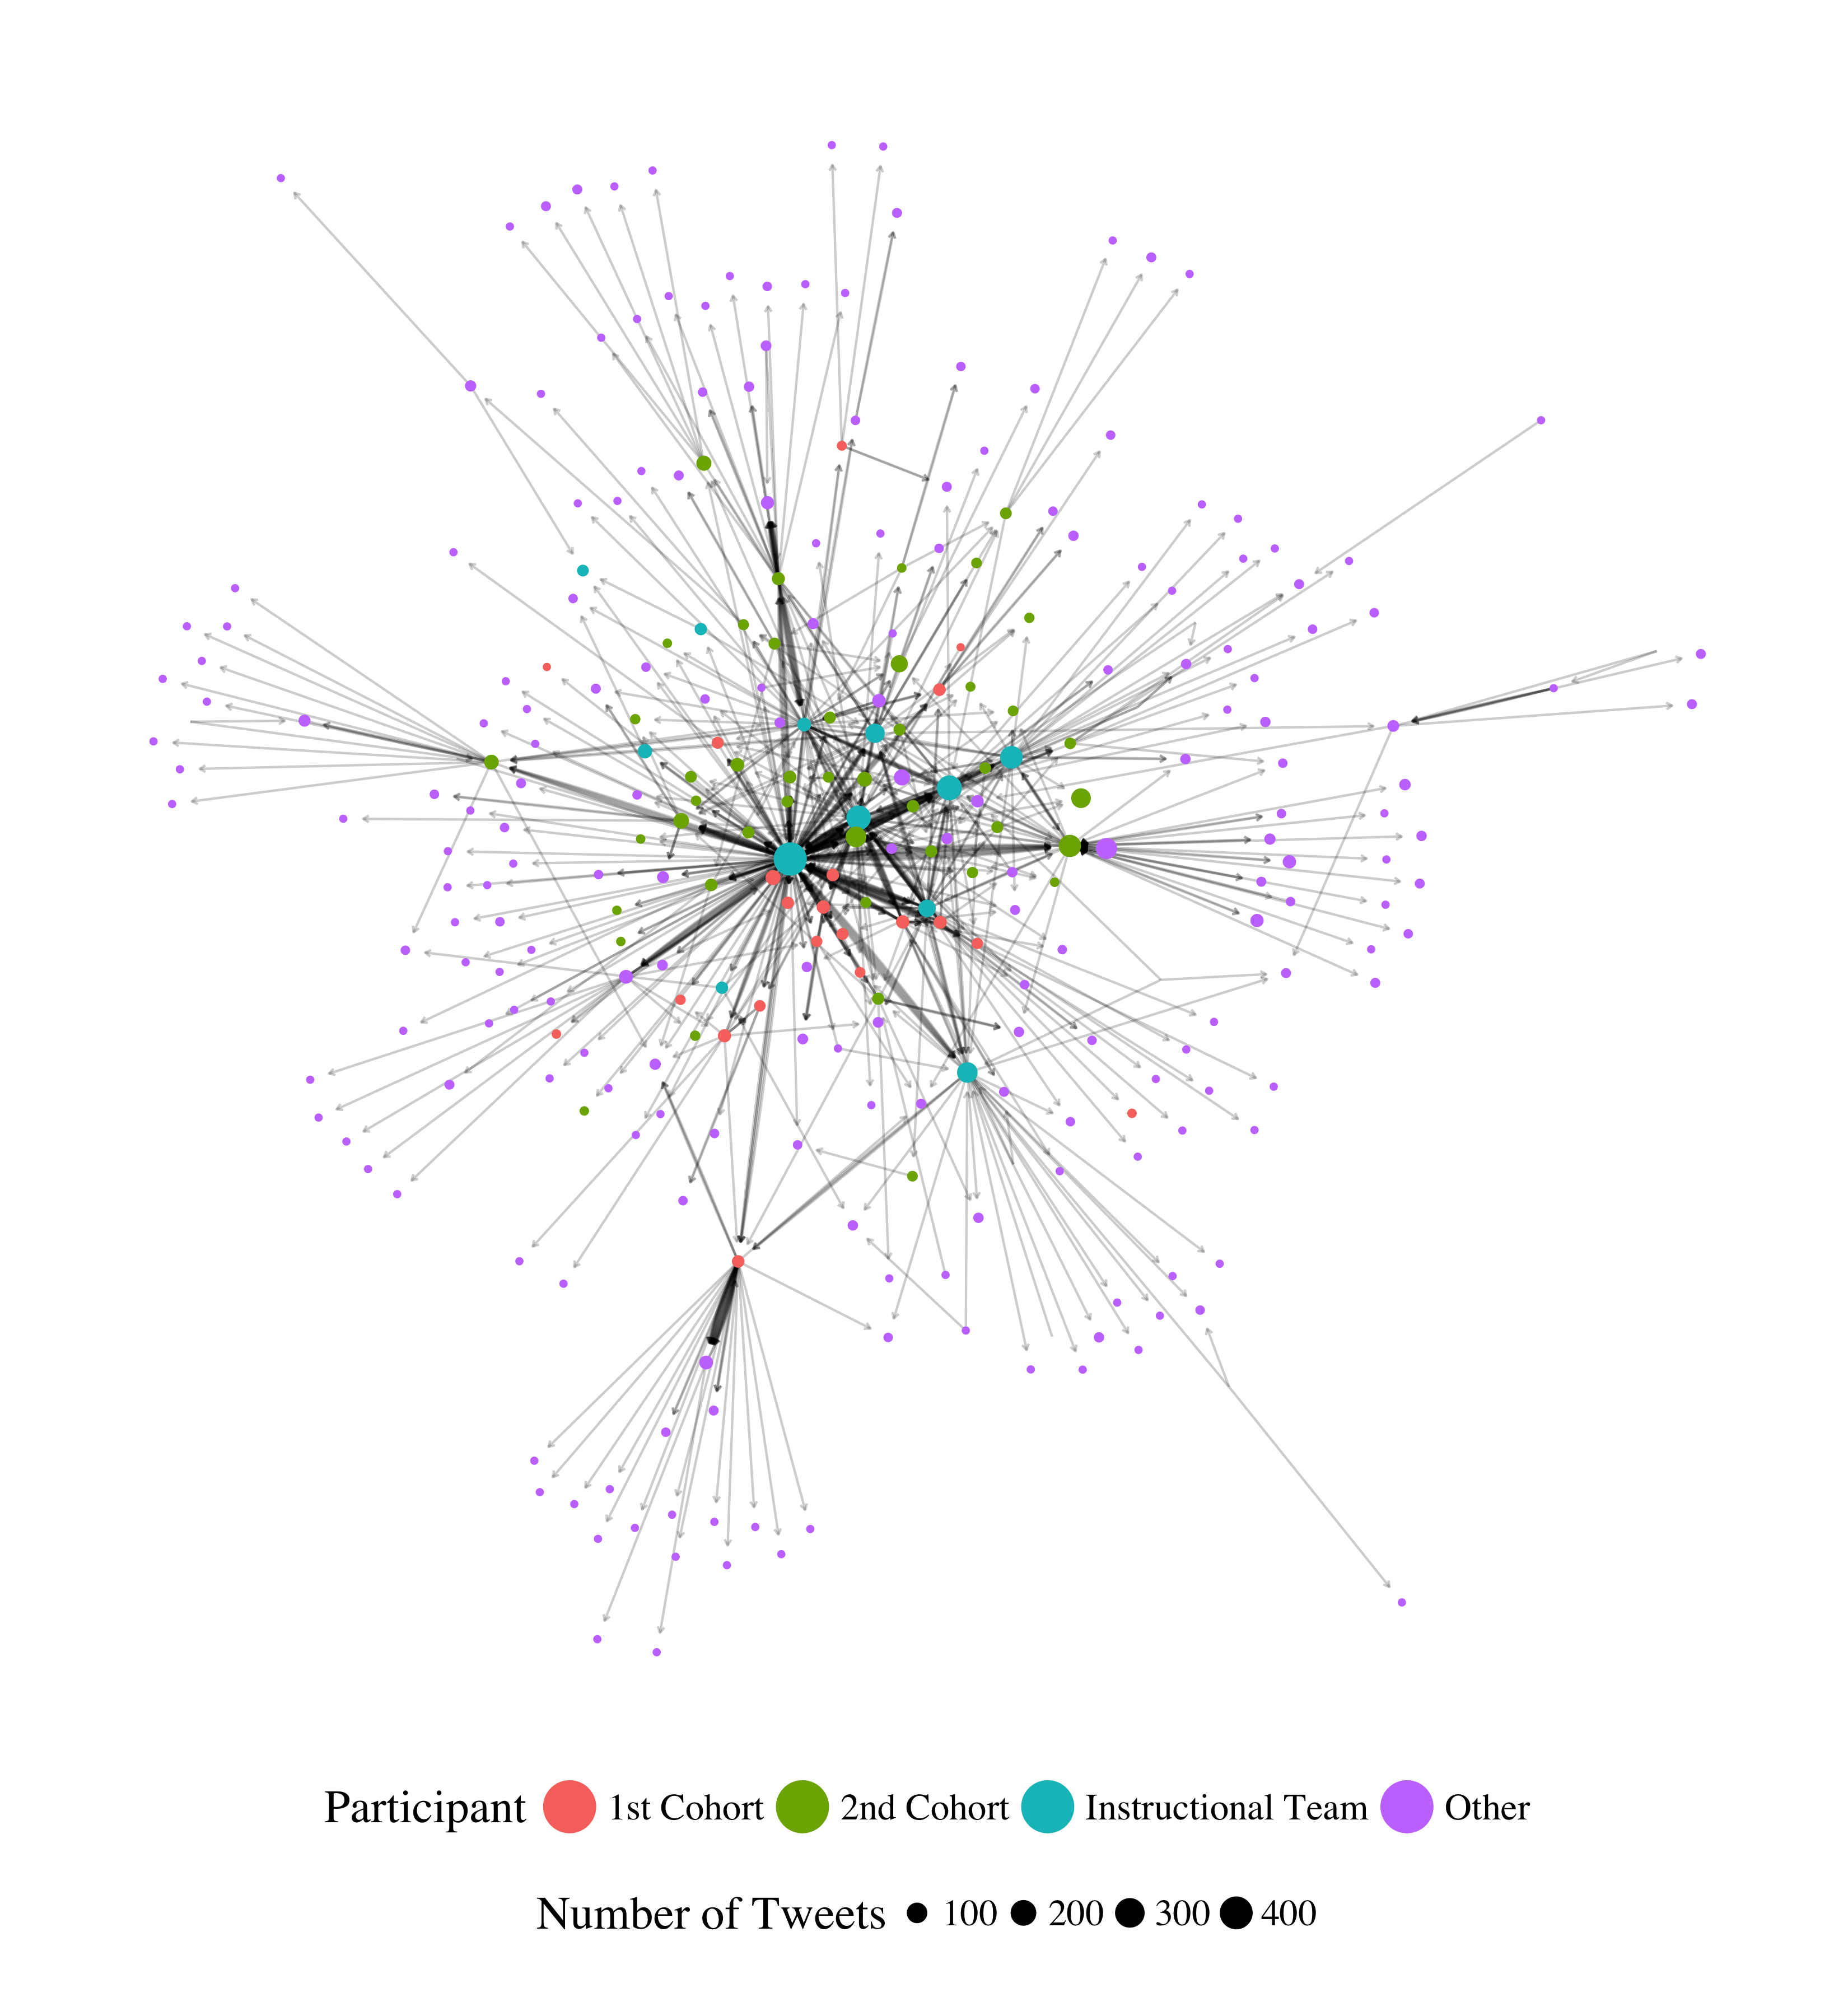
Introduction | ESM | Text | Digital Traces | Future Work | Conclusion
Different roles that teachers played in the network
Prominent role of instructors and relative infrequency of cross-cohort conversing
Presented these findings to instructors and to students and to foster cross-cohort endorsing and conversing
Notes:
Conversing (replying and mentioning) network. Need to think through how to introduce this – maybe zoom in on part and label the parts.

Slide 51
Introduction | ESM | Text | Digital Traces | Future Work | Conclusion
Text Data
Experience Sampling Method
Digital Traces
Future Work

Slide 52
Summary: Identifying their affordances
Introduction | ESM | Text | Digital Traces | Future Work | Conclusion
Text data
Understand teachers and learners in their own words
Experience sampling method (ESM)
Understand learning and engagement at moment-to-moment level
Digital traces
Understand teaching and learning in authentic settings
Notes:
These are the guiding questions that setup the use and discussion of affordances of different data sources and then illustrations of what we can learn from them.
Goal is to show strengths of what kind of research we can do.
Big picture - need to convey this
need to show data source
How the studies are connected
How the studies fit in with the aim
What they help us understand about teaching and learning

Slide 53
Summary: Illustrating what we can learn
Introduction | ESM | Text | Digital Traces | Future Work | Conclusion
Text data
How middle school teachers do scientific modeling in their practice
Experience sampling method (ESM)
How students engage in science activities and work with data
Digital traces
How portfolios can be used to understand technological knowledge
Notes:
These are the guiding questions that setup the use and discussion of affordances of different data sources and then illustrations of what we can learn from them.
Goal is to show strengths of what kind of research we can do.
Big picture - need to convey this
need to show data source
How the studies are connected
How the studies fit in with the aim
What they help us understand about teaching and learning

Slide 54
Future Work
Introduction | ESM | Text | Digital Traces | Future Work | Conclusion
Supporting students to do data science
Supporting teachers to work with data
Leveraging the network effect to scale innovations
Notes:
Need to think of how to introduce this.

Slide 55
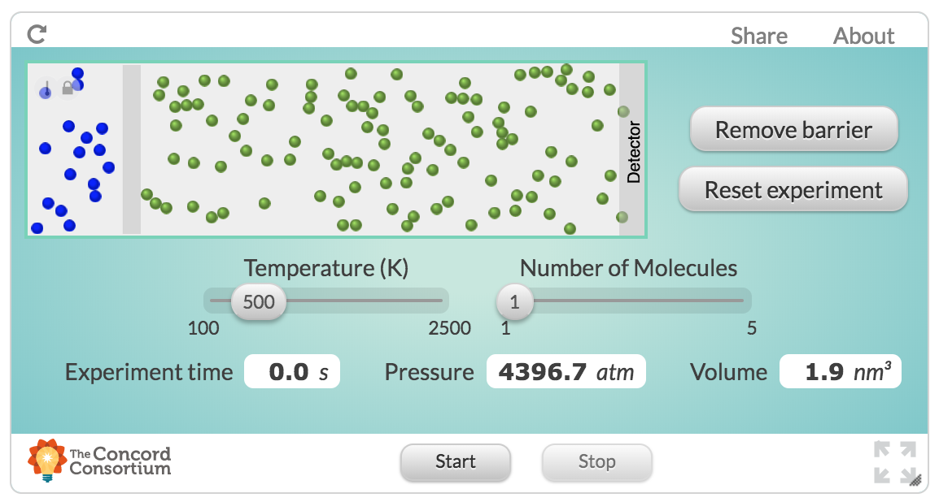
Supporting students to do data science
Introduction | ESM | Text | Digital Traces | Future Work | Conclusion
Past studies were not in contexts not designed and developed to help teach students data science

Slide 56
Supporting students to do data science
Introduction | ESM | Text | Digital Traces | Future Work | Conclusion
Build on collaboration with Michigan Virtual School (Rosenberg, 2017, MVLRI RPIN) to design activities and tools to make it easier for students to use data in online science classes
Focus on data wrangling (accessing, organizing, and transforming data) to expand opportunities to work with data
Partner with faculty across departments at University of Tennessee, Knoxville to support and document work with data at post-secondary level
Strong potential for funding (NSF DRK-12)

Slide 57
Supporting teachers to work with data
Introduction | ESM | Text | Digital Traces | Future Work | Conclusion
Teachers find the shift toward more open-ended work with data to be challenging and working with teachers to study and show how these activities are possible is important

Slide 58
Supporting teachers to work with data
Introduction | ESM | Text | Digital Traces | Future Work | Conclusion
Engage pre-service and in-service teachers in coursework and opportunities to ”hands-on” work with data
Explore how work with in mathematics and engineering classes allows learners to more deeply engage in science as part of a positive “feedback loop”
Potential for collaborative work across the Theory and Practice of Teacher Education department and impact on teacher preparation coursework
Opportunities to involve teachers in design and development of technological tools (i.e., support TPACK)

Slide 59
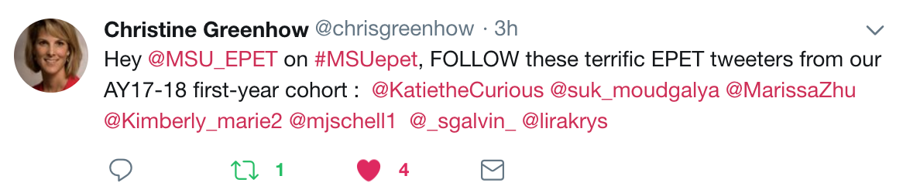
Leveraging the network effect
Introduction | ESM | Text | Digital Traces | Future Work | Conclusion
Scale innovations in STEM teaching and learning through Digital Traces

Slide 60
Leveraging the network effect
Introduction | ESM | Text | Digital Traces | Future Work | Conclusion
Understand how involvement in formal and informal digital communities supports changes in practice
Understand how access to specific resources or people at specific times impacts involvement in a community
Opportunities for expanding impact and carrying out research through foundations (Gates Foundation and programs focused on addressing equity through Digital Traces of researchers, administrators, and practitioners)

Slide 61
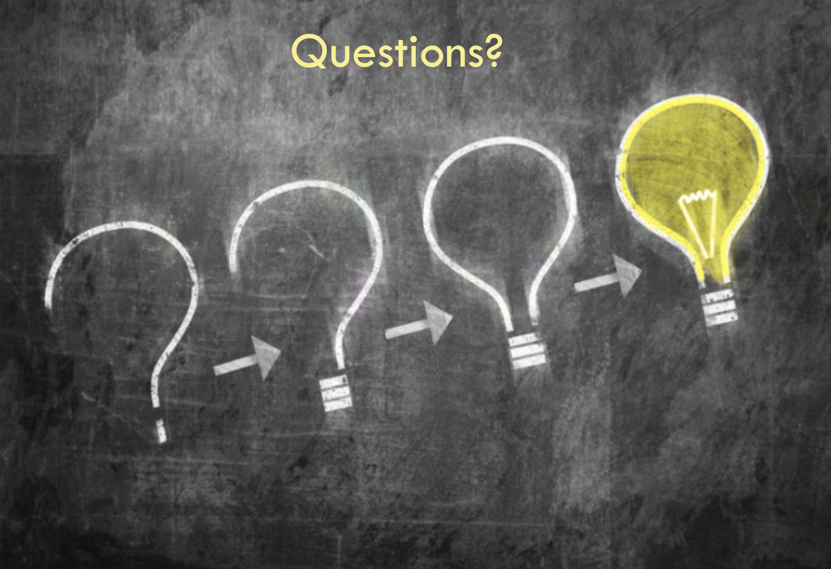
Introduction | ESM | Text | Digital Traces | Future Work | Conclusion
Thank you to participating teachers and students and to collaborators!
Joshua Rosenberg jrosen@msu.edu
http://jmichaelrosenberg.com
@jrosenberg6432
Michigan State University
Notes:
Demonstrate how data can be used to empower teachers and students.

Slide 62
References
Introduction | ESM | Text | Digital Traces | Future Work | Conclusion
Cobb et al., 2003
Turner & Noley, 2015
Mishra, Koehler, & Greenhow, 2016
NGSS Lead States, 2015
National Research Council, 2012
Severance et al., 2012
Wilkerson-Jerde & Wilensky, 2015
Rosenberg & Koehler, 2015
Rosenberg et al., 2016
Koehler et al., 2016
Schmidt, Rosenberg, & Beymer, 2018
Beymer, Rosenberg, & Schmidt, in press
Akcaoglu, Rosenberg, Ranellucci, & Schwarz, 2018
Notes:
Demonstrate how data can be used to empower teachers and students.

